Slide 1
Methodology for computing the UTCI 1) Estimate the mean radiant temperature (MRT) as in (Napoli,2020)*, but integrating eqn. 6 over the entire daily light time 2) Get the UTCI values from lookup tables. ESM-4 of (Brode et al, 2012)**. In the case of CMIP6 data the variables used are tasmax, hursmax, sfcWindmax, rsds, rsus,rlds, rlus. No model used in this study, except for the IPSL historical r1i1p1f1 has rsdsdiff and is assumed to be zero when calculating the MRT.
* https://doi.org/10.1007/s00484-020-01900-5
** https://doi.org/10.1007/s00484-011-0454-1

Slide 2
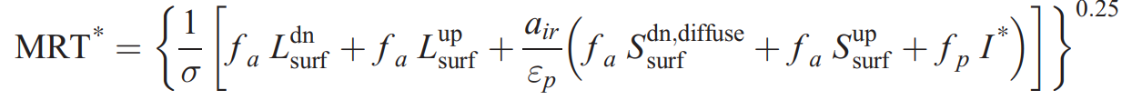
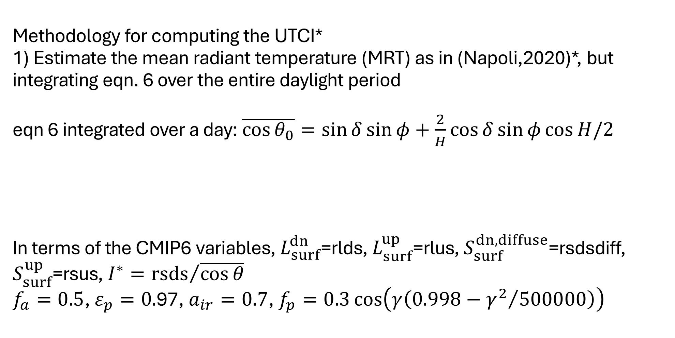
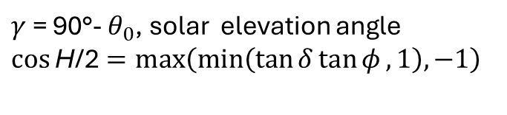
Methodology for computing the UTCI* 1) Estimate the mean radiant temperature (MRT) as in (Napoli,2020)*, but integrating eqn. 6 over the entire daylight period eqn 6 integrated over a day: $\overline{\cos{θ_{0}}}=\sin{δ}\sin{φ}+\frac{2}{H}\cos{δ}\sin{φ}\cos{H/2}$ In terms of the CMIP6 variables, $L_{surf}^{dn}$=rlds, $L_{surf}^{up}$=rlus, $S_{surf}^{dn,diffuse}$=rsdsdiff, $S_{surf}^{up}$=rsus, $I^{∗}={rsds}/{\overline{\cos{θ}}}$ $f_{a}=0.5$, $ε_{p}=0.$97, $a_{ir}=0.7$, $f_{p}=0.3\cos\left(γ\left(0.998−{γ^{2}}/{500000}\right)\right)$
Solar declination
Average solar Azimuth
Latitude
Duration of daylight (in hours angle)
$γ$ = 90°- $θ_{0}$, solar elevation angle
$\cos{\text{H}\text{/2}}=max\left(min\left(\tan{δ}\tan{φ},1\right),−1\right)$
* https://doi.org/10.1007/s00484-020-01900-5

Slide 3
2) Get the UTCI values from look-up tables. ESM-4† of (Brode et al, 2012)**. Linear Interpolation of the look-up tables to the CMIP6 model values
** https://doi.org/10.1007/s00484-011-0454-1
† https://static-content.springer.com/esm/art%3A10.1007%2Fs00484-011-0454-1/MediaObjects/484_2011_454_MOESM2_ESM.zip

